Slide 1
1) Introduction Primer

Slide 2
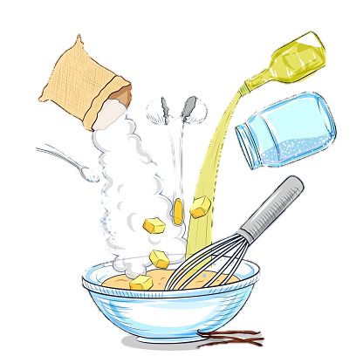
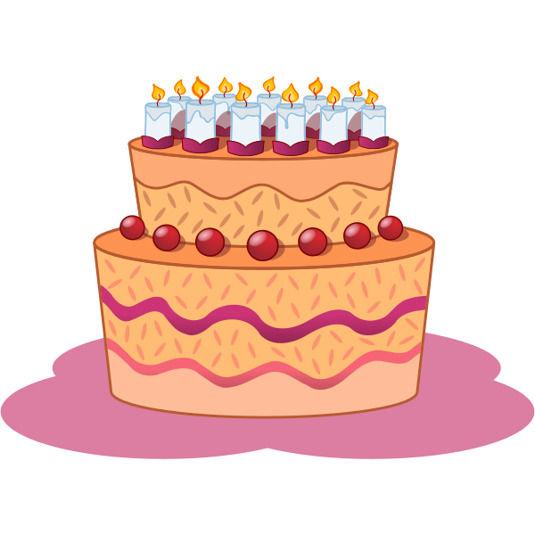
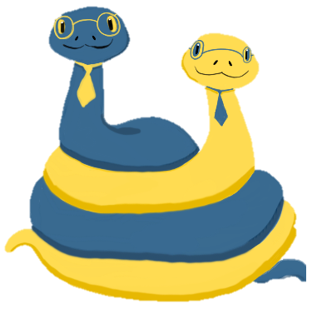
The Python Bakery

Slide 3
Part A
Primer
Lessons
Quizzes
Coding
Part B
Lessons
Quizzes
Coding
1. Introduction
2. Functions
3. If Statements
4. Structures
6. For Loops
7. Sequences
8. Nested Data
9. Time
5. Project/Midterm 1
10. Project/Midterm 2

Slide 4
?
?
?

Slide 5
1.1) Introduction

Slide 6
Computer Science
Problem-solving

Slide 7
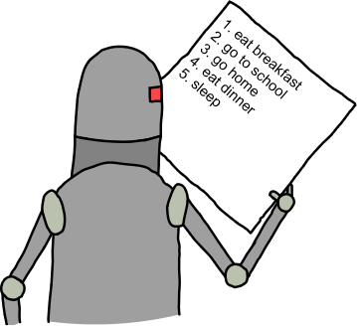

Slide 8


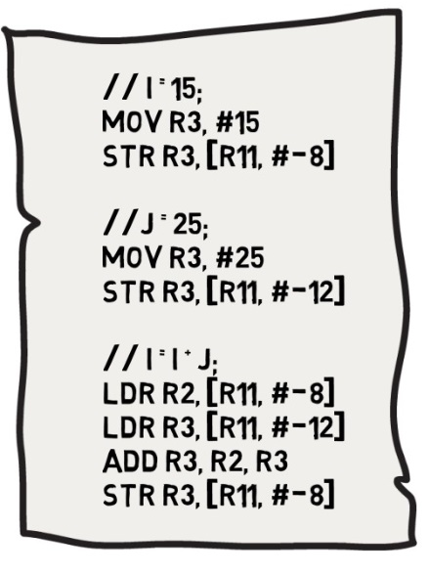
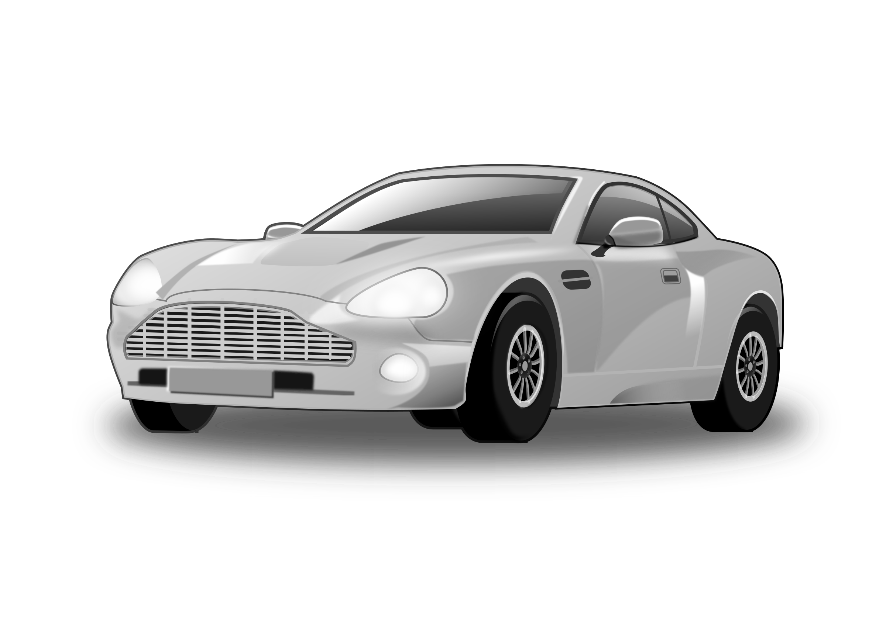


Slide 9

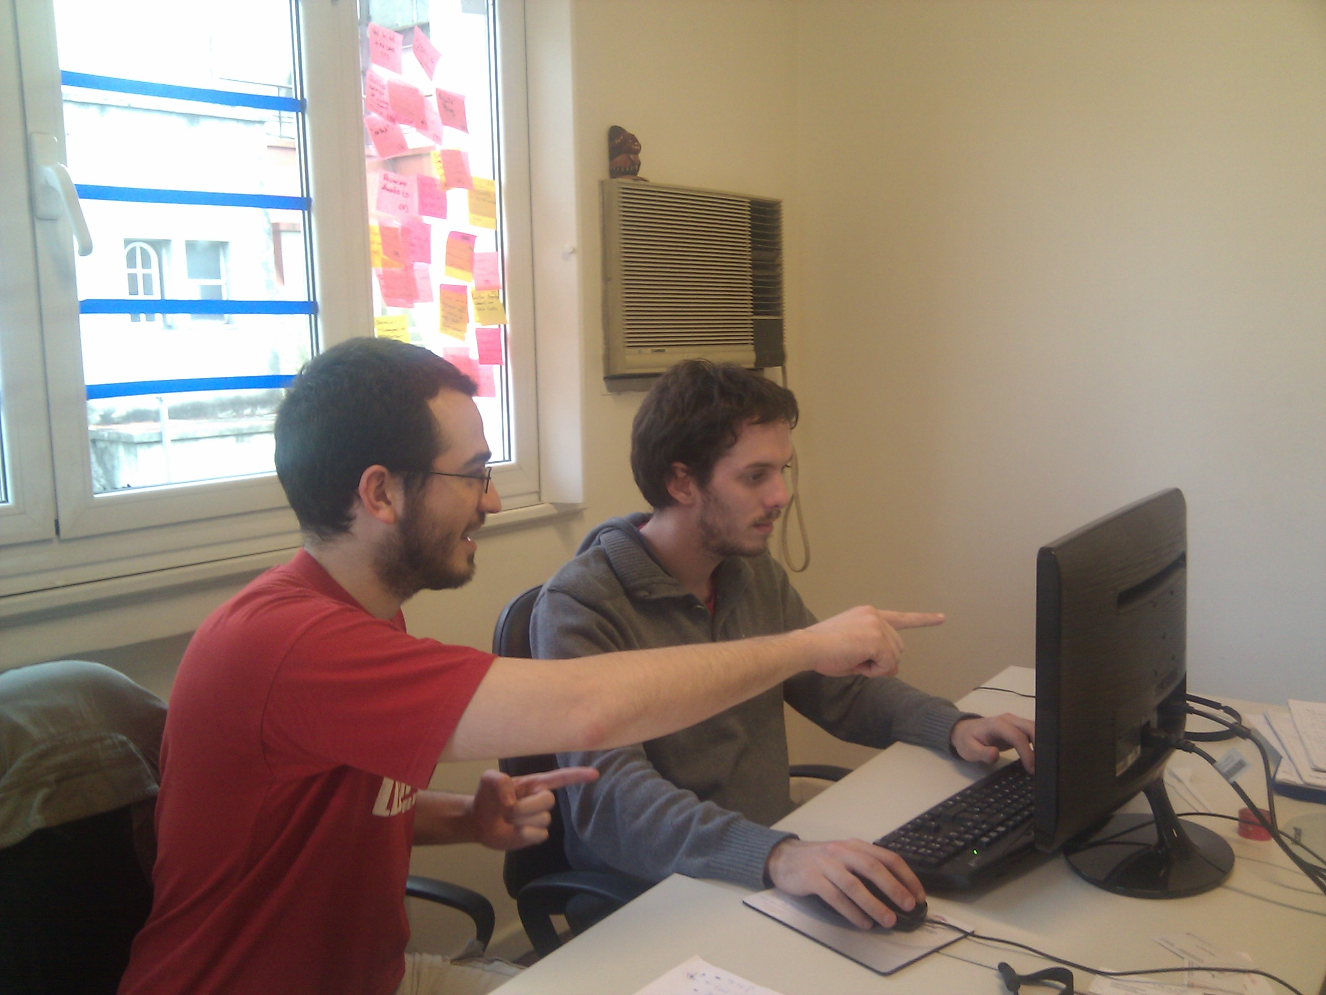
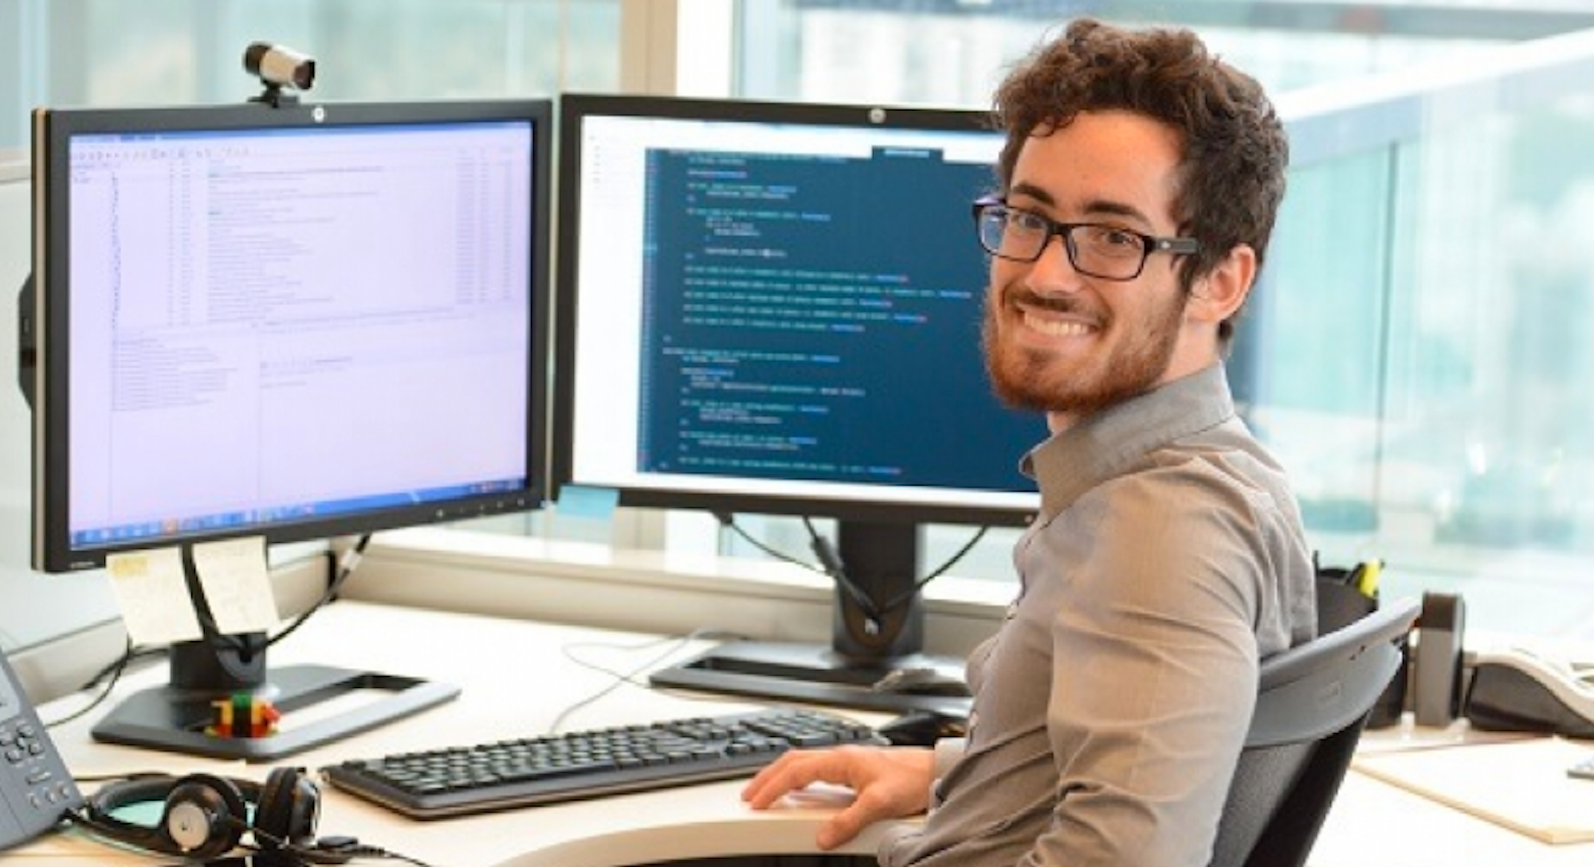
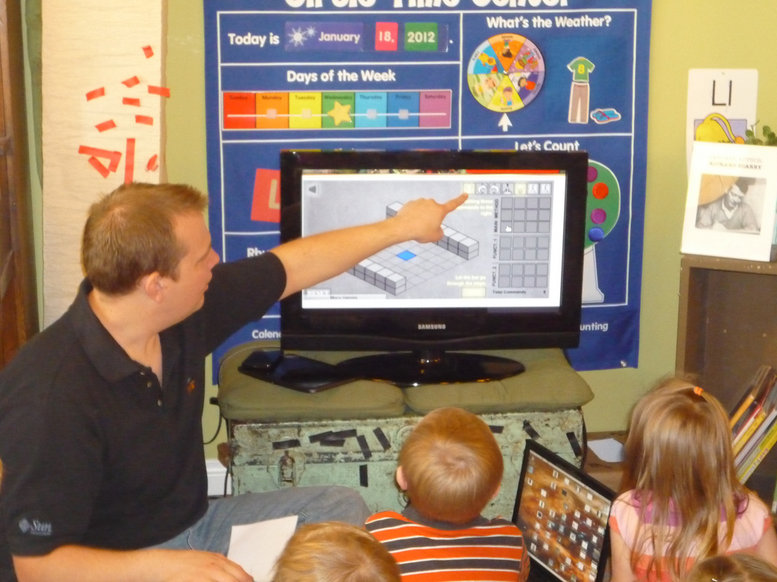
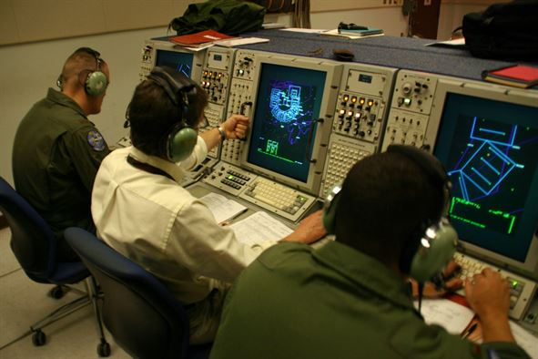
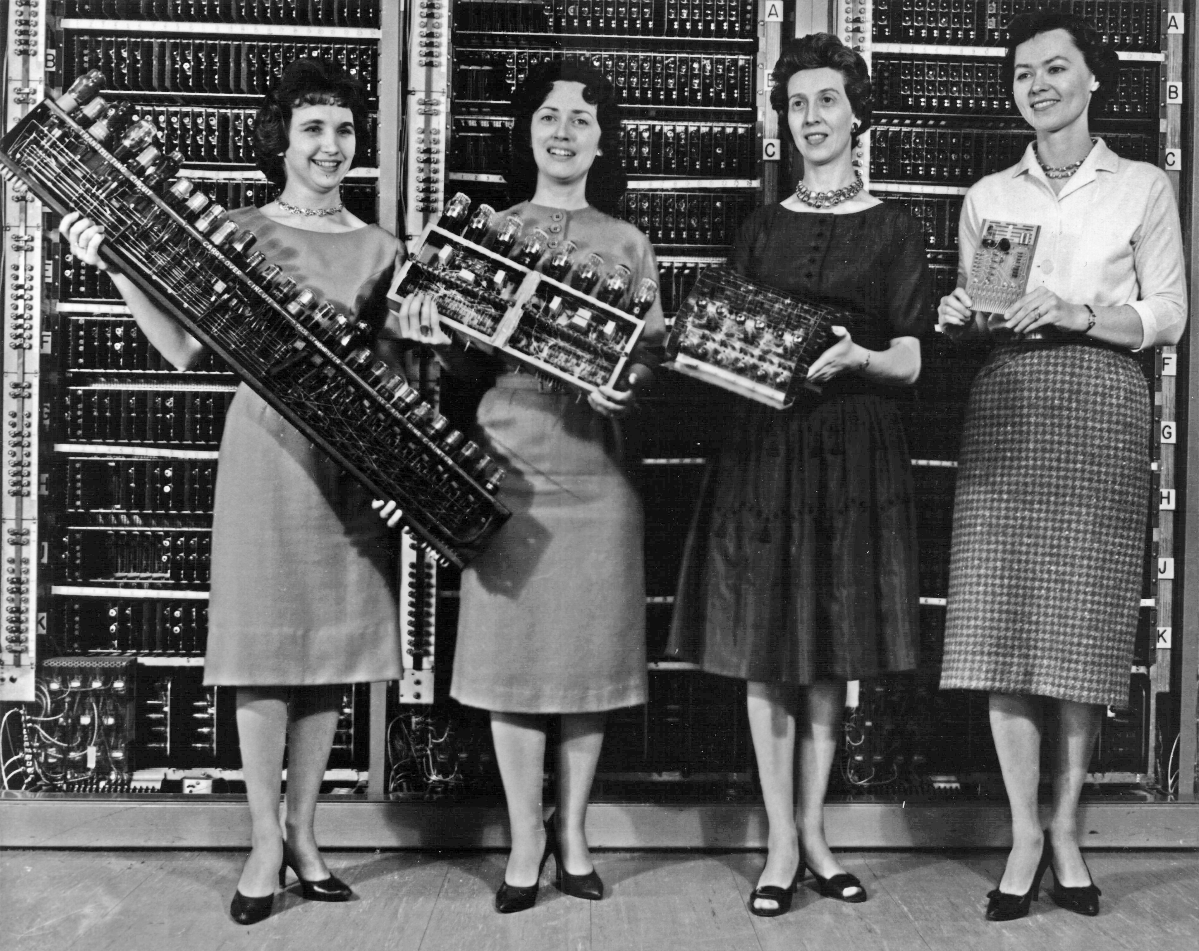
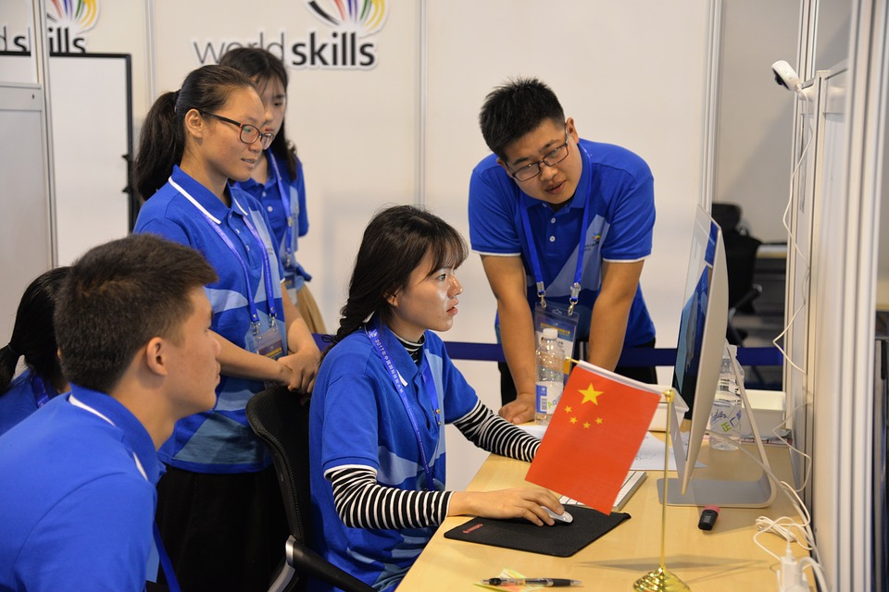
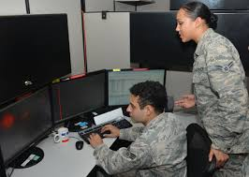

Slide 10




Slide 11
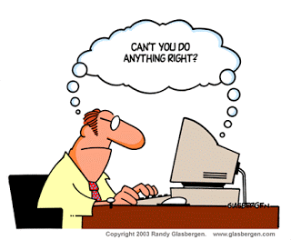

Slide 13
1.2) Programs

Slide 14
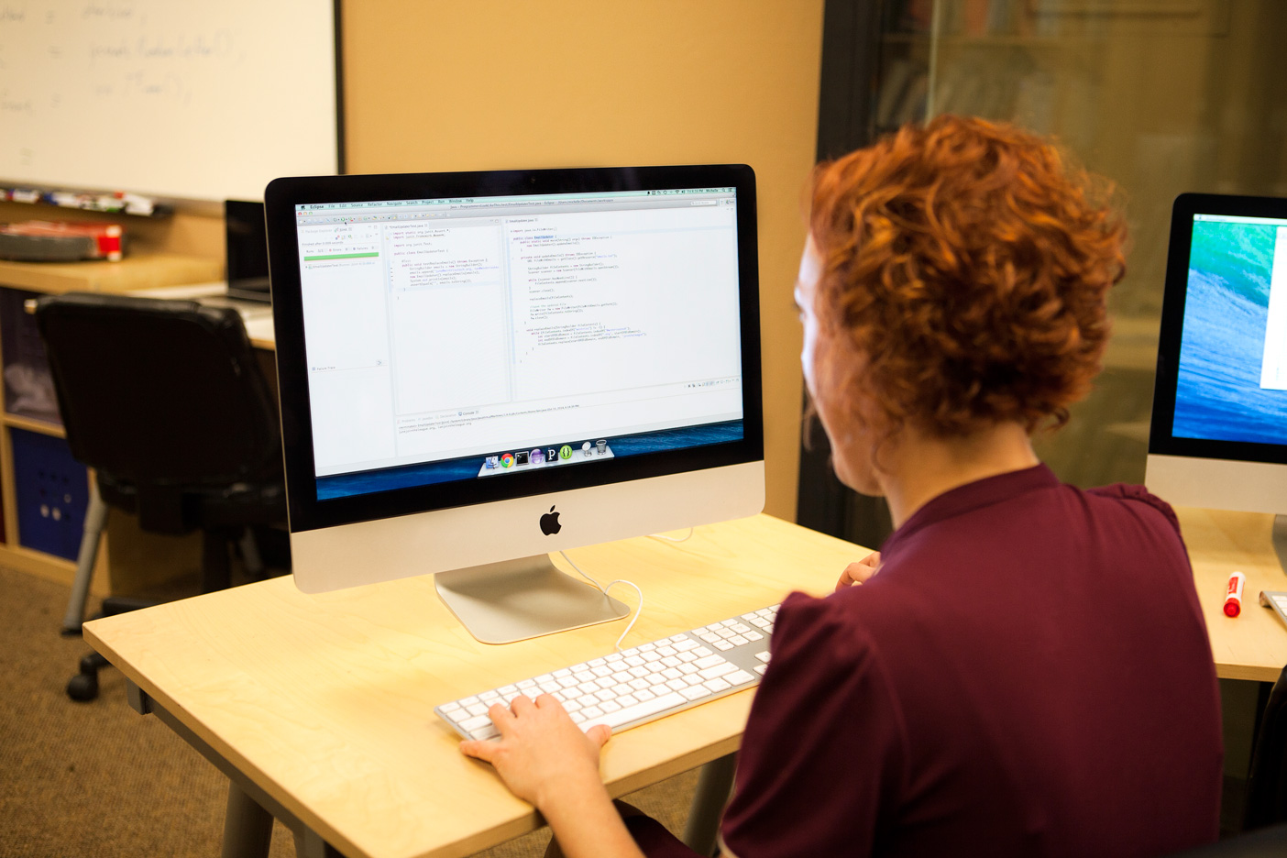
OPEN THE FILE
INITIALIZE THE SUM
READ EACH LINE OF FILE
FOR EACH LINE,
CONVERT LINE TO NUMBER
ADD VALUE TO THE SUM
PRINT THE RESULT

Slide 15
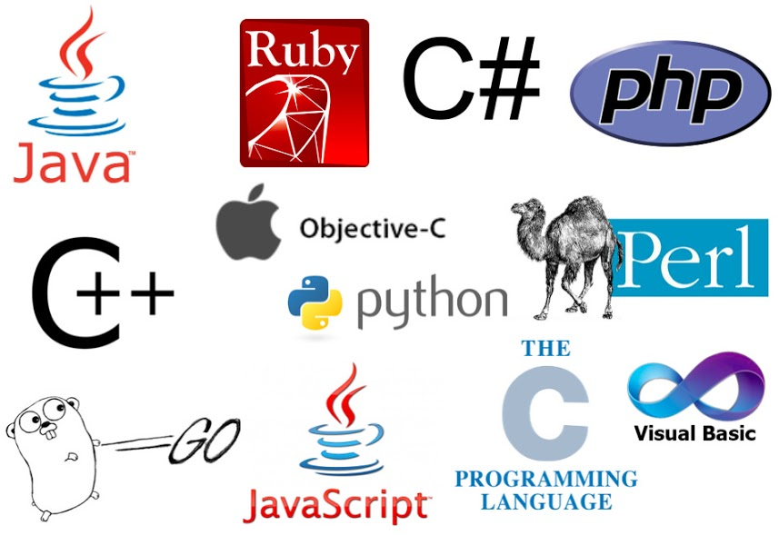

Slide 16
1) Popular
2) Useful
3) Friendly
Rank | Language | Rating
1 | Python | 13.44%
2 | C | 13.13%
3 | Java | 11.59%
4 | C++ | 10.00%
5 | C# | 5.65%
Application Area
Scientific Computing
Web Servers
Data Science
Game Development
Scripting Language
…
Tiobe Index Ratings July 2022

Slide 17
Human Languages
Debate
Instructions
Programming Languages
Instructions
Poetry
…

Slide 18

Sum?
Sum up all the numbers on that paper!
Paper?
All?

Slide 19
Capitalization?
"Run can . upwAys the, to healp?!?"
Period?
Spelling?

Slide 20
Ideas can't sleep?
"Colorless green ideas sleep furiously"
Colorless, but green?
Sleeping furiously?

Slide 21
my_code.py
Line 1
Line 2
Line 3
Line 4
….

Slide 22
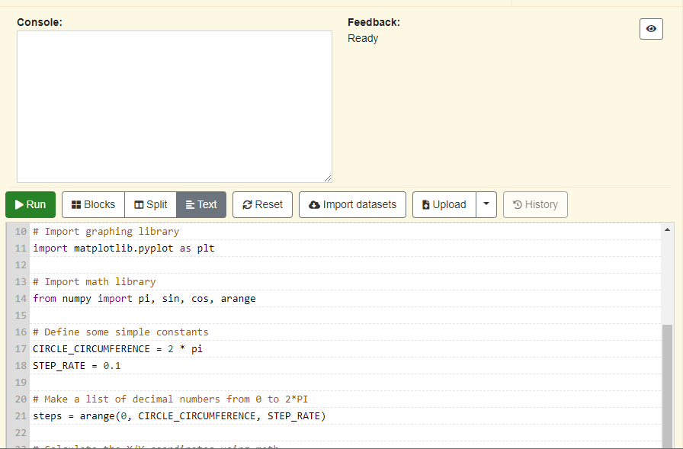
Output Area
Run Button
Program Editor

Slide 23
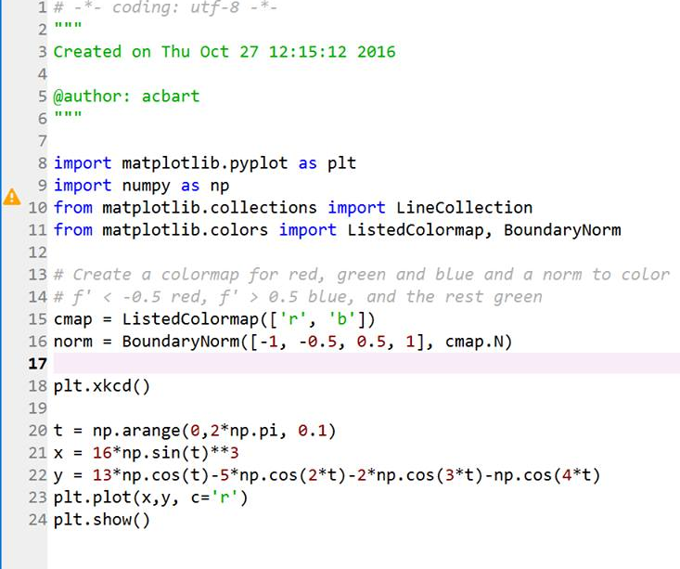


Slide 24
1.3) Console

Slide 25
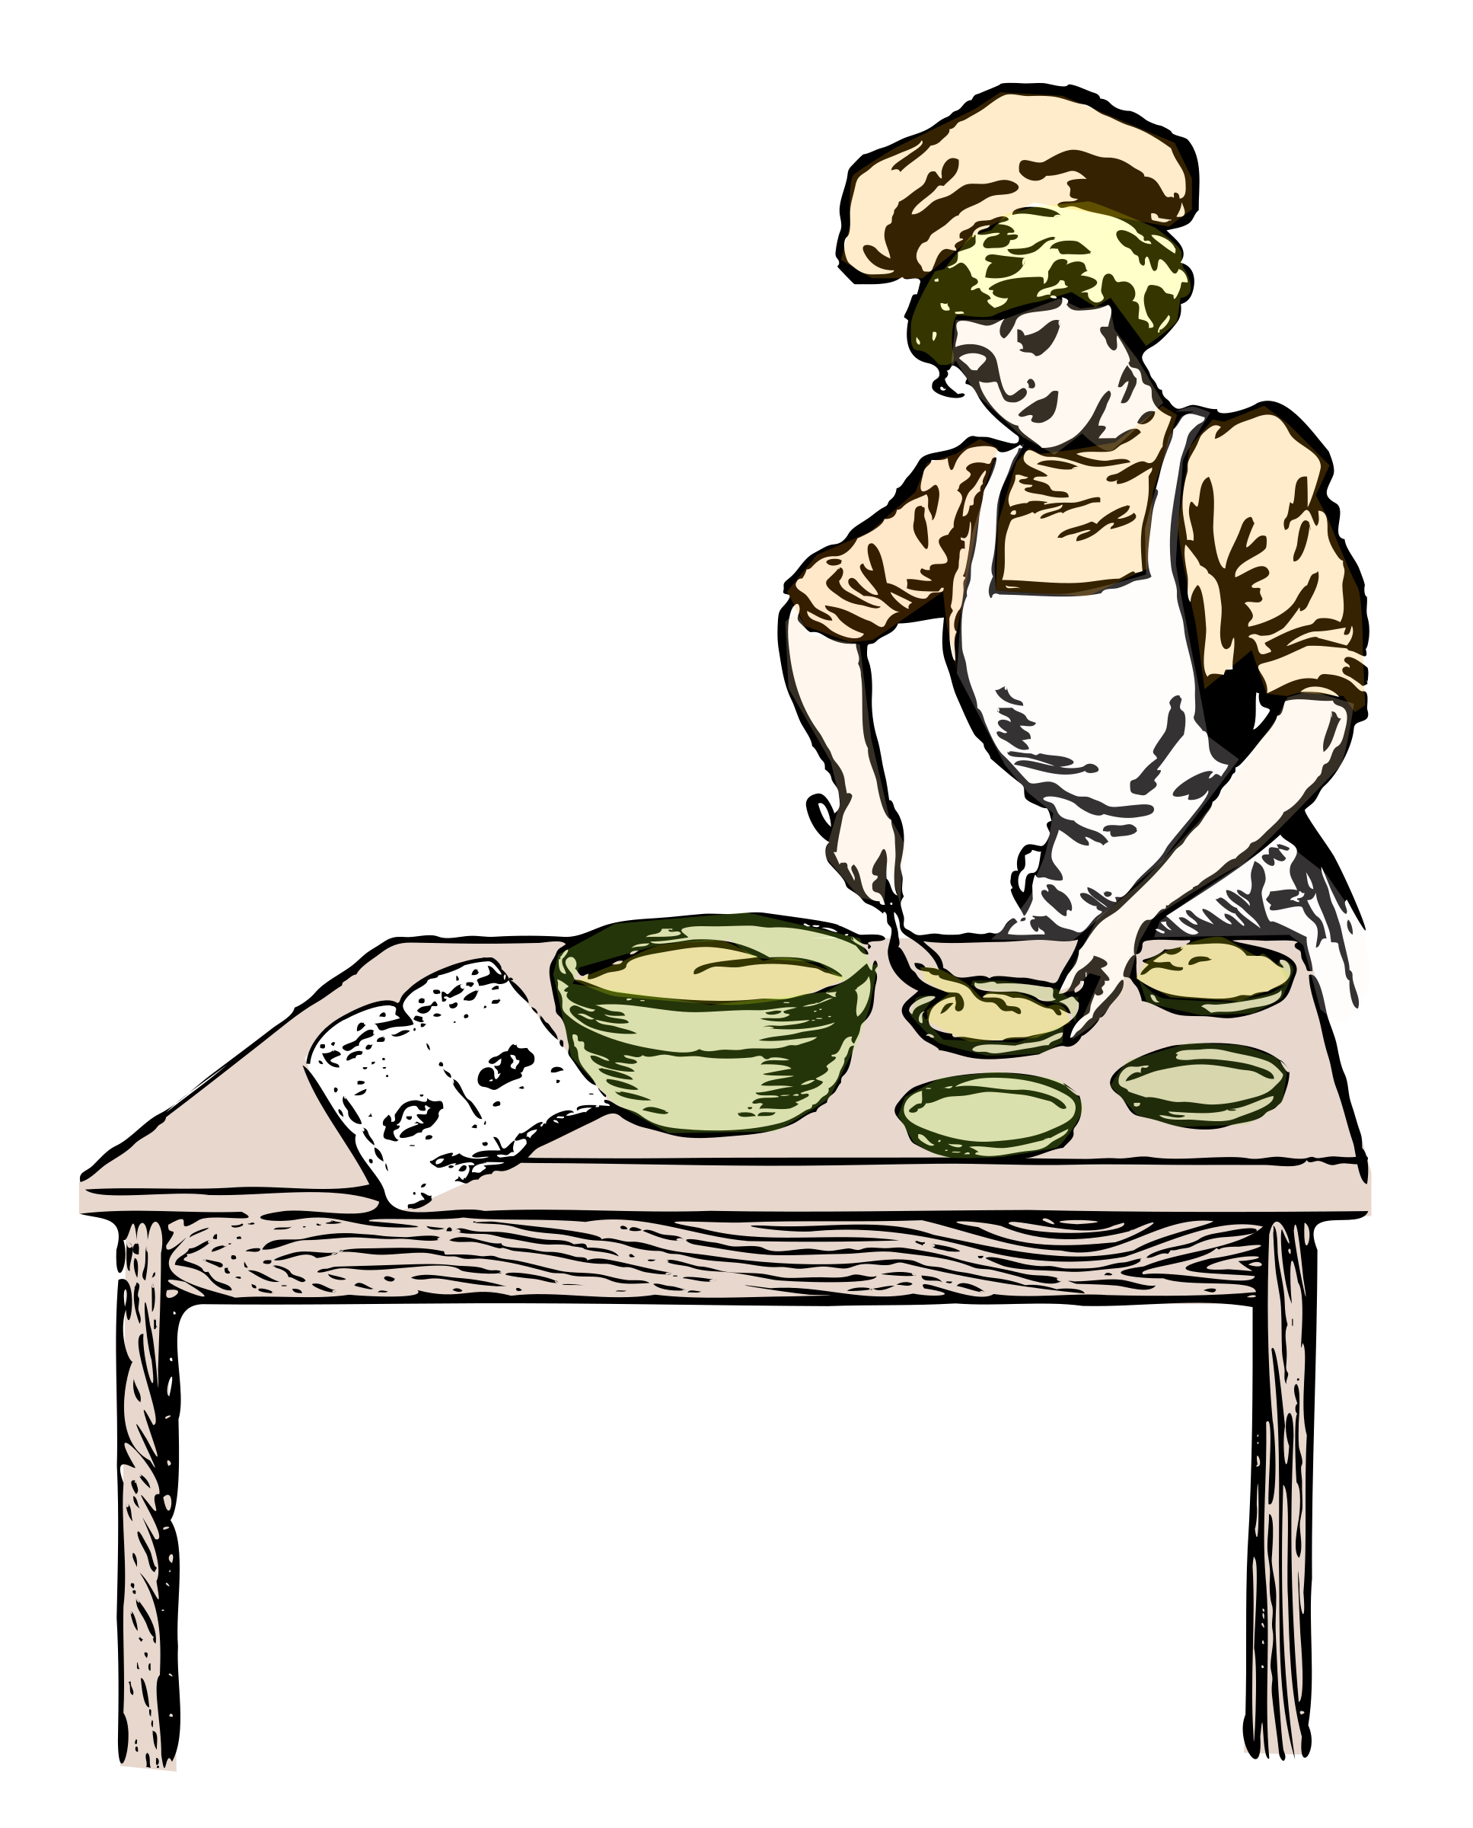
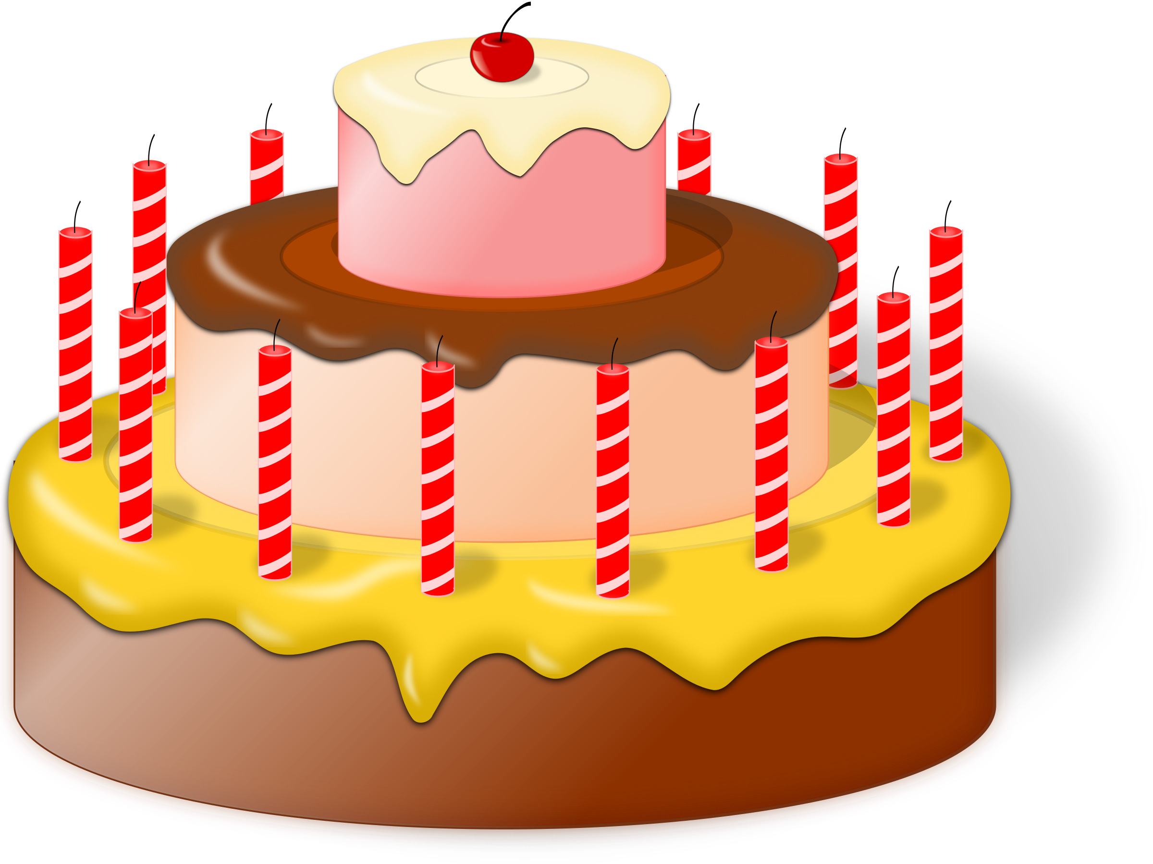
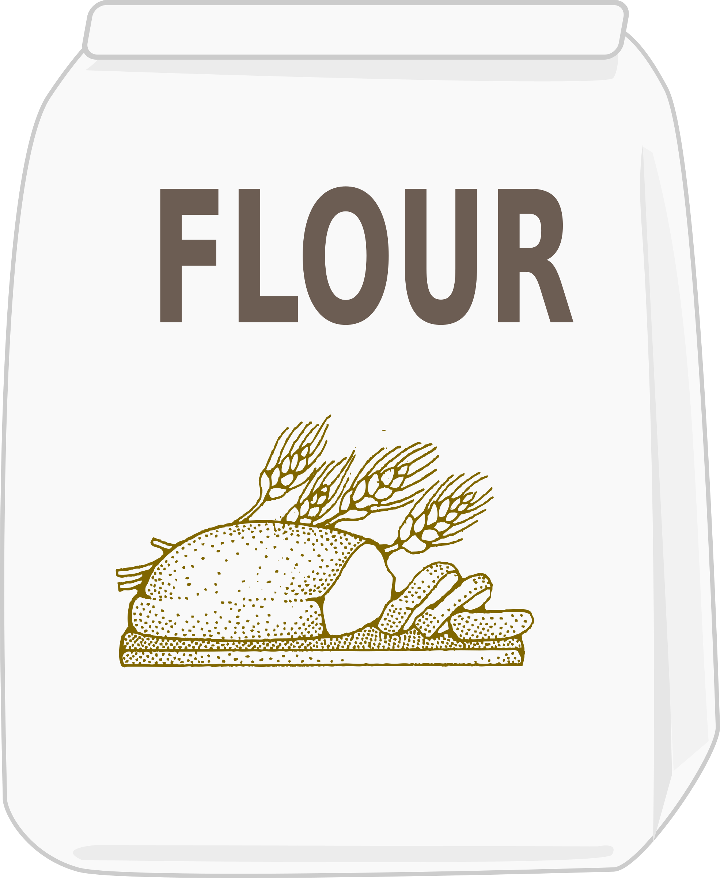

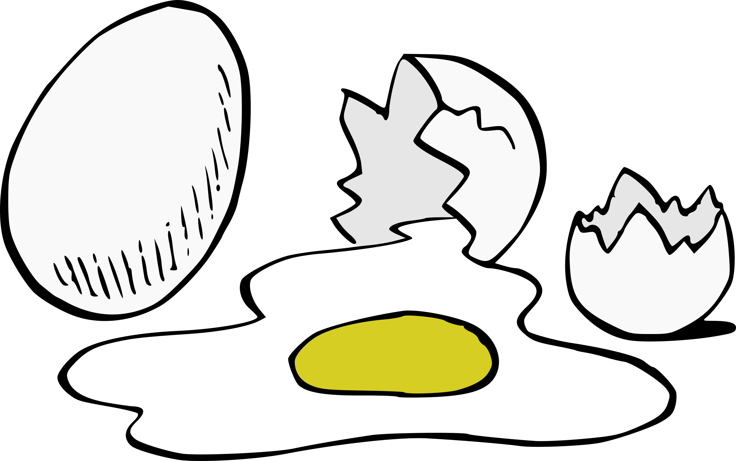
Inputs
Outputs
Processing

Slide 26




Slide 27




Slide 28
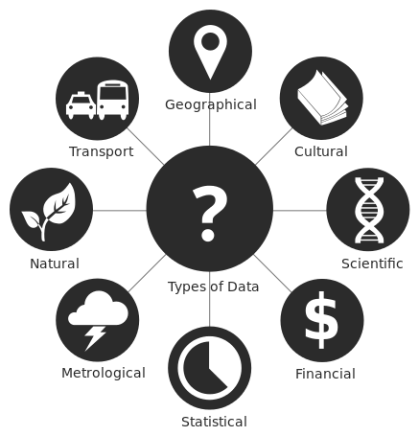

PYTHON
"File:Data types - en.svg." Wikimedia Commons, the free media repository. 8 Jul 2017, 18:52 UTC.7 Aug 2017, 04:42
<https://commons.wikimedia.org/w/index.php?title=File:Data_types_-_en.svg&oldid=250696408>.

Slide 29
1.4) Values

Slide 30


Slide 31
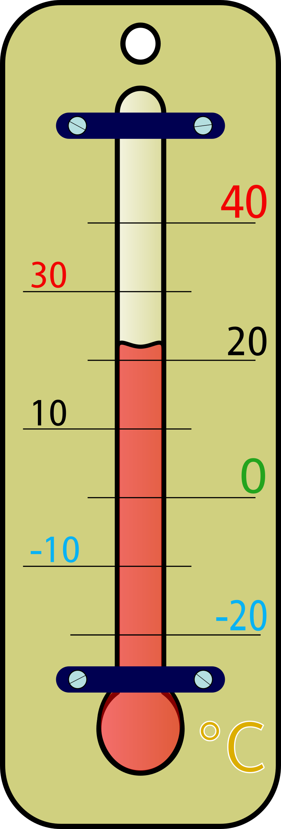
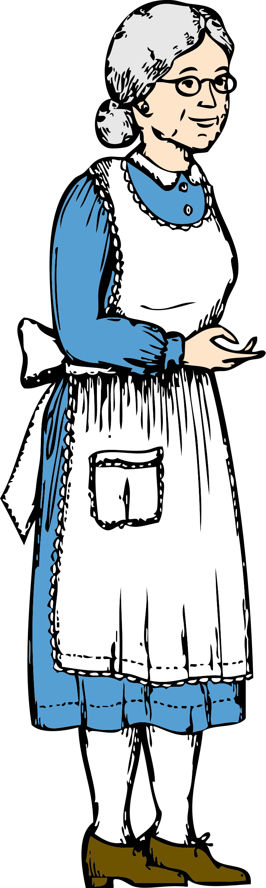

23.4
74
“It was the best of times, it was the worst of times.”

Slide 32

Age of my dog?
Money in my wallet?
17
Current
temperature?
My current age?

Slide 33
1A6) Intro - Math

Slide 34
2+2

Slide 35
1B1) Variables

Slide 36
87
Can come out later!
Data goes in…
total_age

Slide 37
1B3) Modules

Slide 38


Slide 39
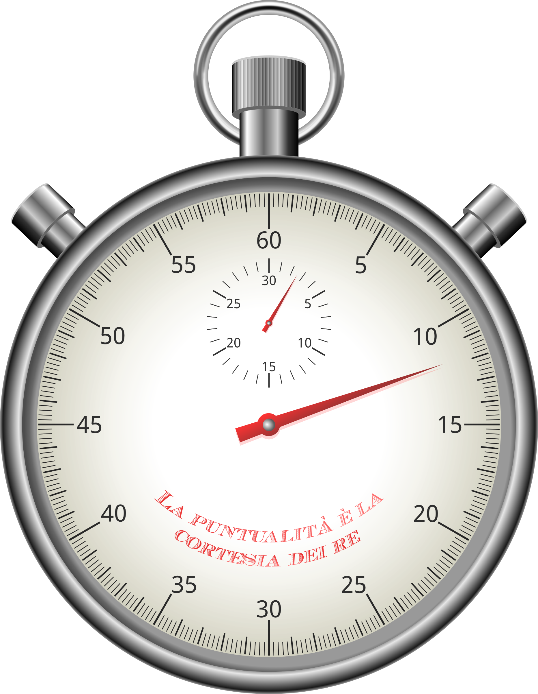
count = 0
print(count)
count = count + 5
count = count + 2
print(count)
Line 1 took 1 millisecond
Line 2 took 3 milliseconds
Line 3 took 2 milliseconds
Line 4 took 2 millliseconds
Line 5 took 3 millliseconds
Total execution time: 11 milliseconds

Slide 40
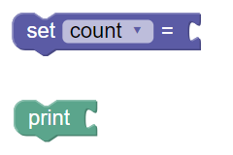
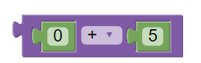
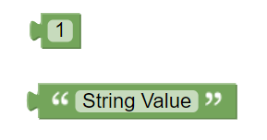
Statements
Expressions
Vertical Notch
Rounded Edge

Slide 41

Chapter 15
Chapter 1
Prologue
Chapter 5

Slide 42
1B4) Comments

Slide 44
1B5) Importing

Slide 45
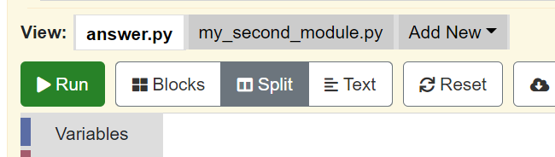

Slide 46
1B6) Strings

Slide 47

"Hello World"

Slide 48
1B7) String Ops

Slide 49
“Hello World!"
0
1
2
3
4
5
6
7
8
9
10
11

Slide 50
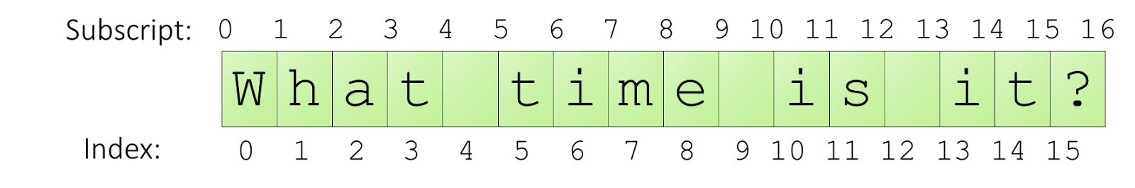
Indexing and Subscripting Tip Use scratch paper!
-16 -15 -14 -13 -12 -11 -10 -9 -8 -7 -6 -5 -4 -3 -2 -1
-16 -15 -14 -13 -12 -11 -10 -9 -8 -7 -6 -5 -4 -3 -2 -1

Slide 51
1B8) Errors

Slide 52


Slide 53
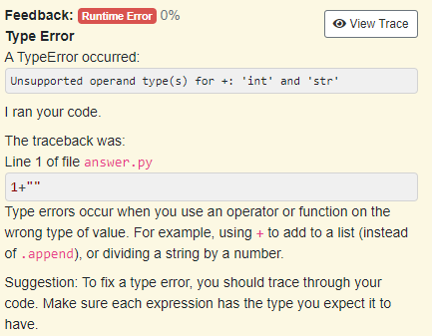

Slide 55



Slide 56
2.A.1. Calling

Slide 57

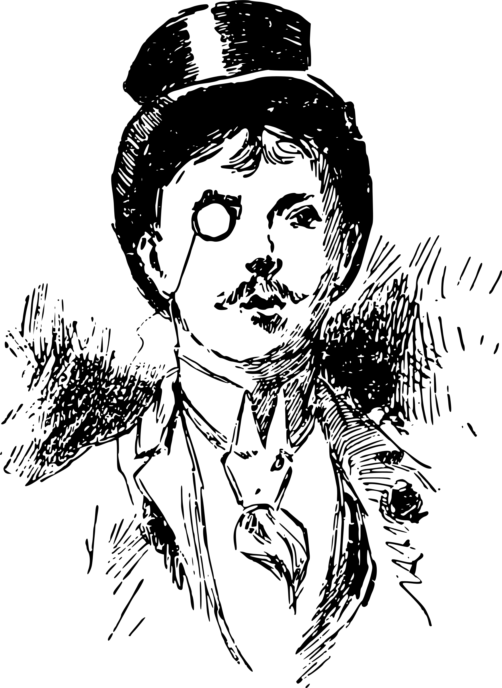

go_to_store
go_to_store()
"Go to the store!"
Talking about going to the store
(without parentheses)
Actually going to the store
(with parentheses)

Slide 58
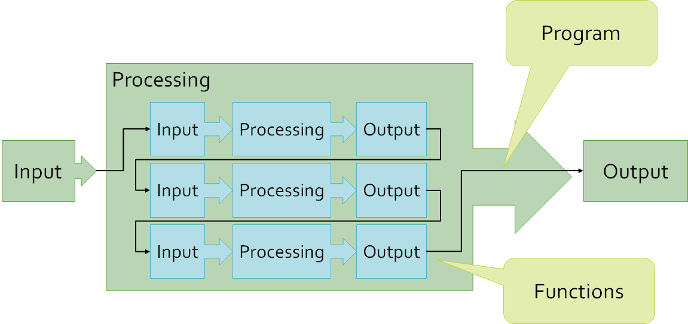

Slide 59
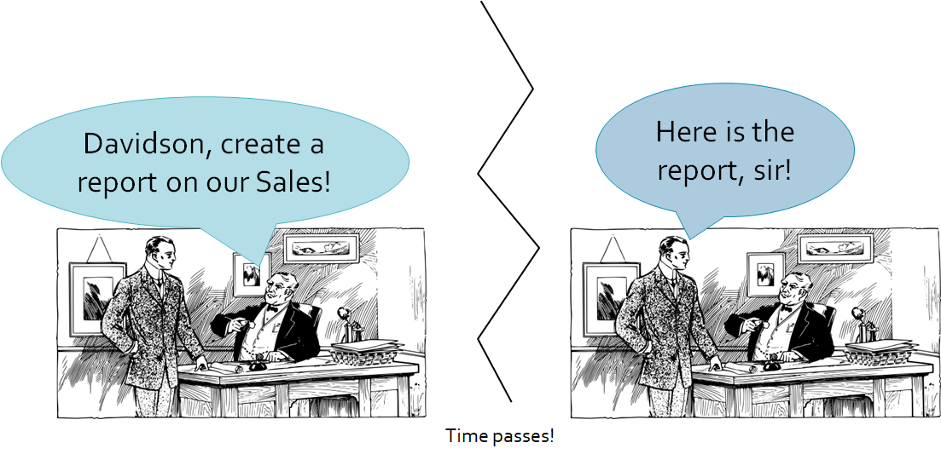

Slide 60
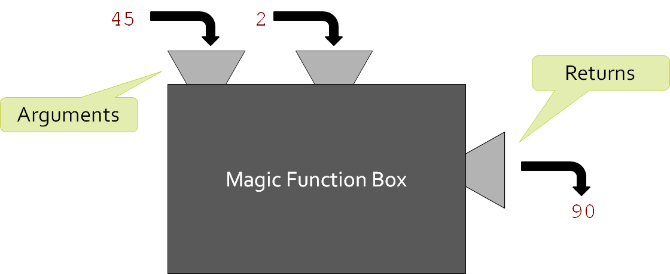

Slide 61
2A2) Builtin Functions

Slide 62
Name: len
Description: The function "len" returns the number of characters in a string (its length).
Syntax:
len(a_string)
Parameters:
a_string (String): The string to calculate the length of
Returns: Integer
Example:
len("Hello World")

Slide 63
Name: len
Description: The function "len" returns the number of characters in a string (its length).
Syntax:
len(a_string)
Parameters:
a_string (String): The string to calculate the length of
Returns: Integer
Example:
len("Hello World")

Slide 64
Arguments
calculate_area(3, 10)
Name: calculate_area
Syntax:
calculate_area(length, width)
Parameters:
length (Integer): The length of the rectangle
width (integer): The width of the rectangle
Parameters

Slide 65
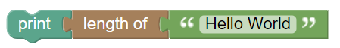
print(len("Hello World"))

Slide 66
"hello world".title().count('o')

Slide 67
string_length = len("hello " + " world ".strip())
Assignment Statement
Function Call
String Addition
Method Call

Slide 68
2A3) Defining Functions

Slide 69

Homemade Functions

Slide 70
Colon
Define Keyword
Parentheses
Name
def name(parameter1, parameter2):
pass
Parameters, with comma
Indentation
Body

Slide 71
2A5) Testing Functions

Slide 72
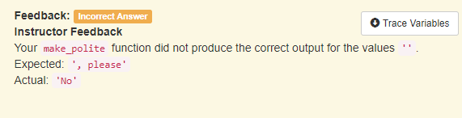

Slide 73
2A6) Debugging Functions

Slide 74
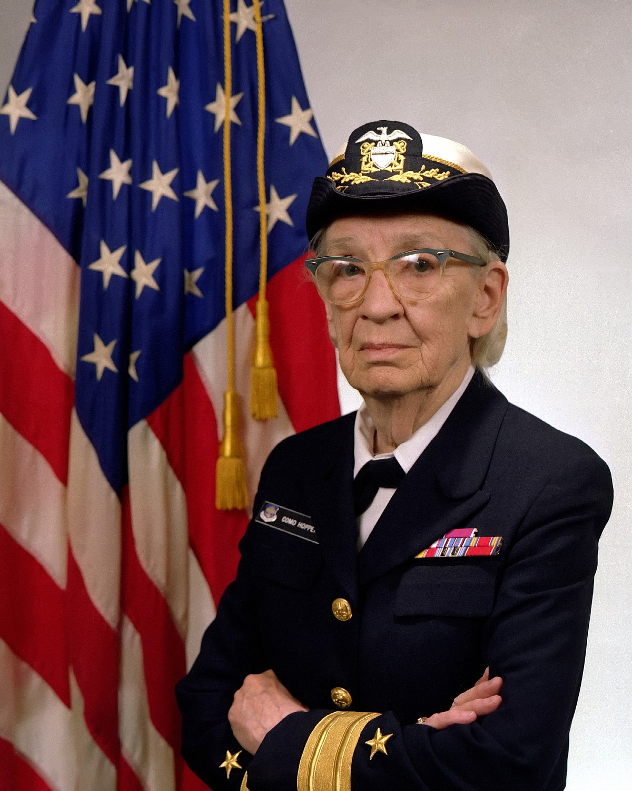
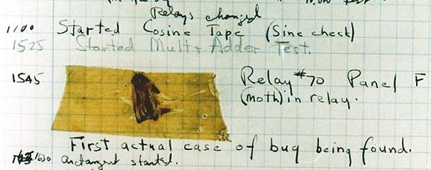

Slide 75

Here it should increase the sum variable. Oh wait, it's decreasing it. My mistake. Thanks rubber duck!

Slide 76
print("Start of program")
def area(length:int, width:int) -> int:
result = length * width
return result
answer = area(3, 4)
print(answer)

Slide 77
2B4) External Functions

Slide 78
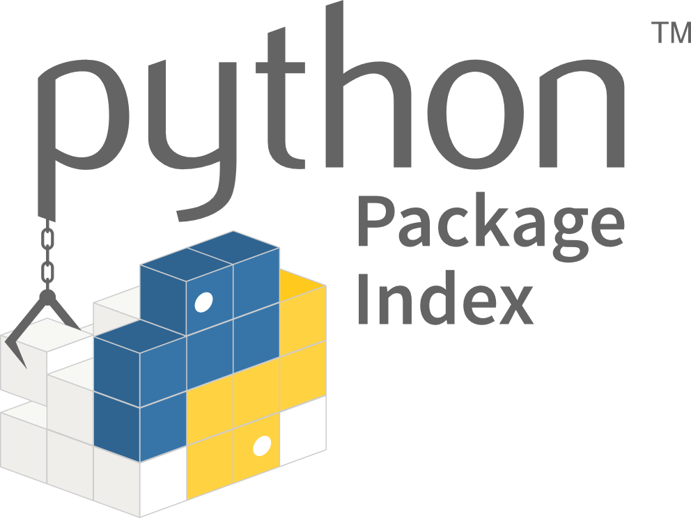

Slide 79
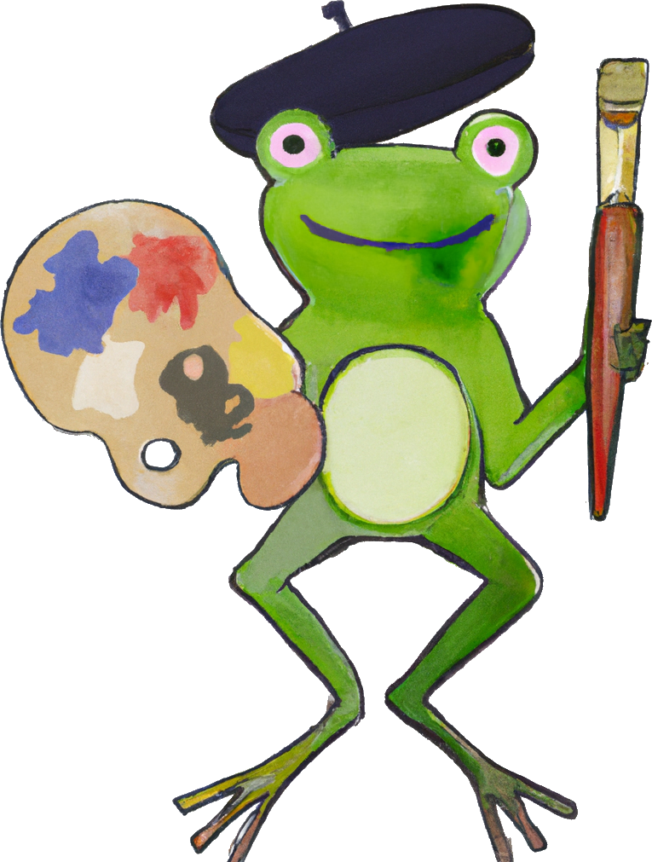
Designer

Slide 80
def add1(number:int)->int:
total = number + 1
return total
total = 3
total = add1(total)
answer = 5
answer = add1(answer)

Slide 81
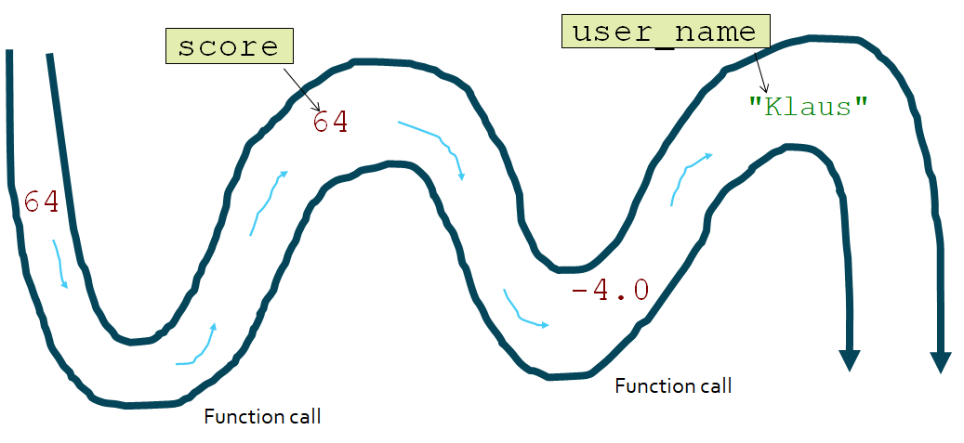

Slide 82
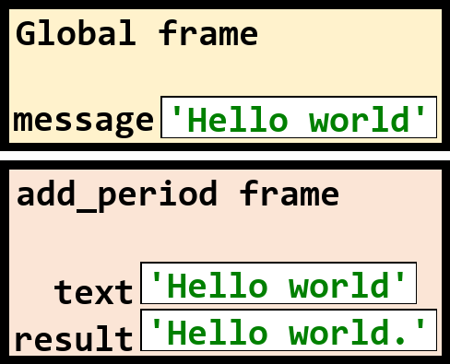
def add_period(text: str) -> str:
result = text + "."
return result
message = "Hello world"
add_period(message)

Slide 83
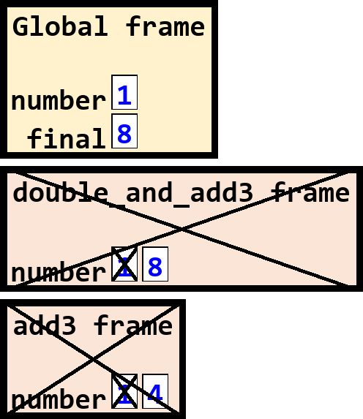
def add3(number: int) -> int:
number = number + 3
return number
def double_and_add3(number: int) -> int:
number = 2 * add3(number)
return number
number = 1
final = double_and_add3(number)

Slide 84
3A1) If Statements

Slide 85
THEN do A
IF ___
Continue…
ELSE do B

Slide 86


IF
THEN bring
ELSE do not.

Slide 87
Conditional
if
keyword
Colon
if expression:
pass
Body
Indentation

Slide 88
if precipitation > 0:
print("It is raining")

Slide 89
Step | Line | age | discount | price
1 | 1 | 25 | X | X
2 | 2 | 25 | X | X
3 | 5 | 25 | 1 | X
4 | 6 | 25 | 1 | 10
1
2
3
4
5
6
age = 25
if age > 60:
discount = .8
else:
discount = 1
price = discount * 10

Slide 90
3A2) Truthiness

Slide 91
Type | False | True
Boolean | False | True
Integer | 0 | Non-zero number (e.g., 5, -3)
Float | 0.0 | Non-zero number (e.g., -3.0, 2.4)
String | "" | Non-empty string (e.g., "Hello")
None | None

Slide 92
3B1) Nesting Ifs

Slide 93
# of Spaces
Code
0
4
8
4
8
0
4
if age > 21:
if cost < 10:
print("Buy")
else:
print("Too expensive")
else:
print("Too young")

Slide 94
else + if
elif
if "dog" in name:
print("Is a dog")
else:
if "cat" in name:
print("Is a cat")
else:
print("Unknown")
if "dog" in name:
print("Is a dog")
elif "cat" in name:
print("Is a cat")
else:
print("Unknown")
Equivalent!

Slide 95
if + if
elif
if "dog" in name:
print("Is a dog")
if "cat" in name:
print("Is a cat")
if "dog" in name:
print("Is a dog")
elif "cat" in name:
print("Is a cat")
NOT Equivalent!

Slide 96
3B3) Events

Slide 97
🥧
🥧
🥧
🥧
🥧
🥧
🥧
…

Slide 98
4A1) Dataclasses

Slide 99
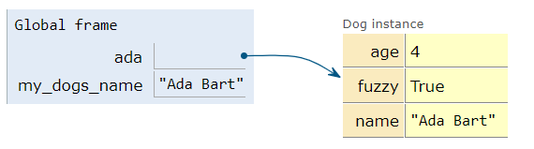
Variables
Values
ada = Dog("Ada Bart", 4, True) my_dogs_name = ada.name

Slide 100
4B1) Lists

Slide 101

[]
10
[10, 20, 30]
20
30

Slide 102
[10, 10, 20, 1, 1]
10
10
20
1
1
0
1
2
3
4

Slide 103
List != Array != Vector

Slide 104
5 Primer) For Loops

Slide 105
Loop Pattern
Actual Code
original_list = ___
# Sum pattern
total = 0
for item in original_list:
total = total + item
print(total)
amounts = ["$1", "$5", "$1", "$10"]
# Sum pattern
total_amount = 0
for amount in amounts:
numeric_amount = int(amount[1:])
total_amount = total_amount + numeric_amount
print(total_amount)

Slide 106
5A1) For Loops

Slide 107
Iteration variable
in keyword
List variable
for keyword
for item in a_list:
pass
Colon
Indentation
Body

Slide 108
Each element in turn is assigned to the iteration variable
for item in a_list:
pass
10
10
20
1
1

Slide 109
for a_price in prices:
adjusted = a_price * .9
print(adjusted)

Slide 110
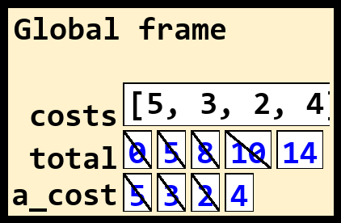
costs = [5, 3, 2, 4]
total = 0
for a_cost in costs:
total += a_cost
print(total)

Slide 111
6B2) Loop Composition

Slide 112
Main Function
Call first helper function
Call second helper function
…

Slide 113
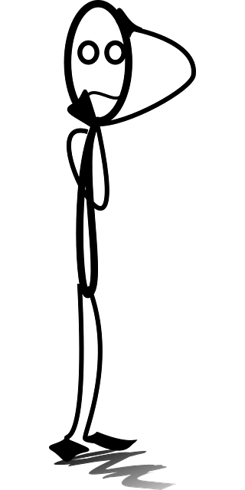
Convert strings to integers
Find the average
Find the sum
Remove negative integers

Slide 114
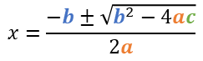
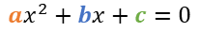
$${ax}^{2}+bx+c=0$$
$$x=\frac{−b±\sqrt{b^{2}−4ac}}{2a}$$

Slide 115
8A1) Lists of Dataclasses

Slide 116
pets: list[Pet]
from dataclassess import dataclass
@dataclass
class Pet:
name: str
age: int
is_fuzzy: bool
kind: str
pets = [Pet("Ada", 4, True, "Dog"),
Pet("Babbage", 5, False, "Dog"),
Pet("Captain", 2, True, "Cat"),
Pet("Domino", 1, True, "Cat")]
Name | Age | Is Fuzzy? | Kind
“Ada” | 4 | True | “Dog”
“Babbage” | 5 | False | “Dog”
“Captain” | 2 | True | “Cat”
“Domino” | 1 | True | “Cat”

Slide 117
8A2) 2D Dataclasses

Slide 118

str
Person
work
Address
state
“DE"
ada.work.state

Slide 119
8B2) Heavy Nesting

Slide 120

Class Diagram

Slide 121

from dataclasses import dataclass
@dataclass
class Event:
name: str
duration: int
@dataclass
class Date:
day: int
month: int
year: int
@dataclass
class Day:
date: Date
events: list[Event]
@dataclass
class Planner:
owner: str
days: list[Day]
calendars = [
Planner("Ada Bart", [
Day(Date(4, 9, 2022), [
Event("Play Fetch", 45),
Event("Nap", 124)
]),
Day(Date(4, 10, 2022), [
Event("Play Fetch", 27),
Event("Nap", 60),
Event("Bork Loudly", 64)
]),
]),
Planner("Babbage Bart", [
Day(Date(4, 9, 2022), [
Event("Nap", 180)
]),
Day(Date(4, 10, 2022), [
Event("Nap", 180)
])
])
]

Slide 122
7B1) Filesystems

Slide 123






Root
School work
Photos
Python
homework2.doc
cs10.xls
Photo1.jpg
Me_irl.jpg
strings.py
example.py

Slide 124
Path
Root
School work
Photos
Python
homework2.doc
cs10.xls
Photo1.jpg
Me_irl.jpg
strings.py
example.py

Slide 125
Command | Description
pwd | print current working directory
ls | list files in current working directory
ls <path> | list files in the directory of the path
cd <path> | change the current working directory to that path
Thonny requires the exclamation mark (!), don’t forget!

Slide 126
7B2) Files

Slide 127
"On the 24th of February, 1815, the look-out at Notre-Dame de la Garde signalled the three-master, the Pharaon from Smyrna, Trieste, and Naples. As usual, a pilot put off immediately, and rounding the Château d'If, got on board the vessel between Cape Morgiou and Rion island."
Count-of-monte-cristo.txt

Slide 128
9A1) While Loops

Slide 129
while Keyword
Conditional
Colon
while condition:
pass
Body

Slide 130
count_down = 4
while count_down > 0:
count_down -= 1
print(count_down)
print("Reached the end")

Slide 131
Executes once
0
1
2
3
4
5
6
count_down = 4
while count_down > 0:
count_down -= 1
print(count_down)
print("Reached the end")
Executes 4 times
Executes once

Slide 132
count_down = 4
while count_down > 0:
count_down += 1
print(count_down)
print("Reached the end")
Variable increases each iteration, never reaching zero. Loops forever!

Slide 133
9B1) Time Complexity

Slide 134
Record
Start Time
Run
Program
Record
End Time
Calculate
Difference
count_down = 4000000
while count_down > 0:
count_down += 1
print(count_down)
print("Reached the end")
=2.73sec

Slide 135
Number of Elements | Running time of program (microseconds)
1 | 2 microseconds
2 | 4 microseconds
10 | 20 microseconds
100 | 200 microseconds
1000 | 2000 microseconds
time = elements * 2

Slide 136
11A1) Plotting

Slide 137


As you can see, most students do very well!

Slide 138



Histogram
Line Plot
Scatter Plot

Slide 139

import matplotlib.pyplot as plt
data = [0, 5, 7, 35, 35,
51, 53, 57, 61, 64,
82, 84, 84, 88]
plt.hist(data)
plt.show()

Slide 140

import matplotlib.pyplot as plt
data = [1, 4, 8, 16, 8, 24, 32]
plt.plot(data)
plt.show()

Slide 141

import matplotlib.pyplot as plt
# S1 S2 S3 S4 S5 S6 S7
exam1 = [40, 43, 55, 60, 52, 63, 74]
exam2 = [50, 55, 67, 72, 70, 71, 70]
plt.scatter(exam1, exam2)
plt.show()

Slide 142

import matplotlib.pyplot as plt
plt.plot([1, 4, 8, 16, 8, 24, 32])
plt.xlabel("Time (Days)")
plt.ylabel("Money (Dollars)")
plt.title("Money over Time")
plt.show()

Slide 143

import matplotlib.pyplot as plt
plt.plot([1, 2, 1, 3, 4], label="First")
plt.plot([3, 4, 4, 5, 6], label="Second")
plt.legend()
plt.show()

Slide 144



Tosi, Sandro. Matplotlib for Python developers. Packt Publishing Ltd, 2009.

Slide 145
11B1) Recursion

Slide 146



Slide 147

Alejandra
Carol
Bob
Danielle
Edward
Gregory
Felienne

Slide 148
Root node
“Nodes”
Alejandra
“Edges”
Parent node
Carol
Bob
Child node
Danielle
Edward
Gregory
Felienne

Slide 149
“Root”
“Node”
“Edge”
“Parent”
Alejandra
Carol
…
Alejandra
“Child”
Felienne
“Leaf”
Felienne

